Slide 1

Data Analysis on Heart Failure Prediction Dataset
-Rahul Jadhav
Aly6000
Professor : Dr Mary D.

Slide 2
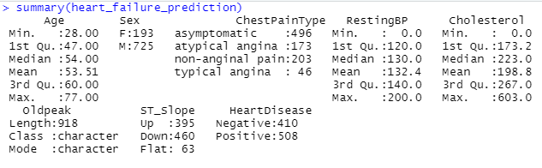
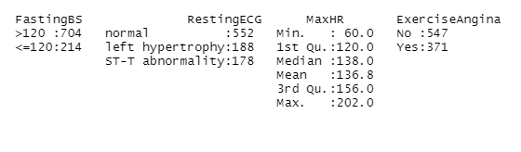
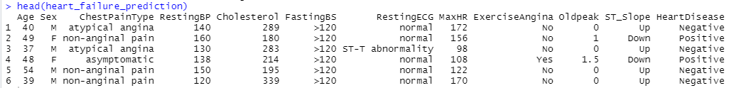
Dataset & Summary
The dataset contains a total of 916 records
The dataset consists of numerical and categorical attributes
We can convert categorical attributes to factor attributes that can help in drawing meaningful insights from the dataset

Slide 3
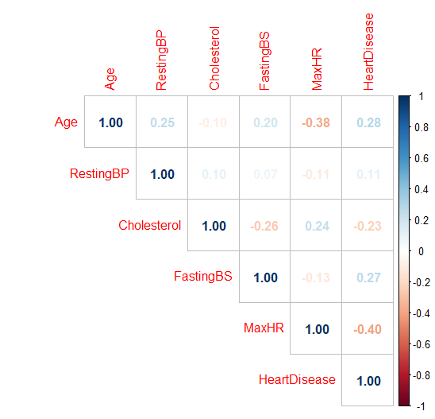
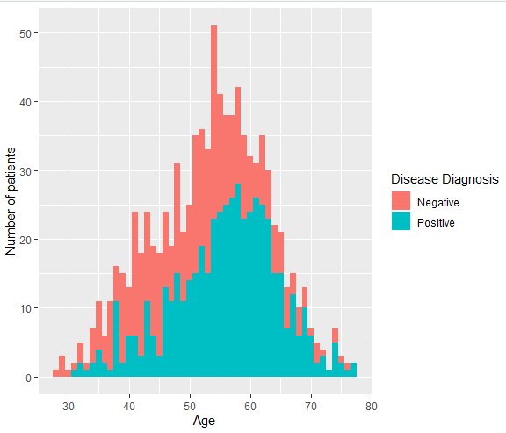
Data Visualization and Key findings
From the correlation plot, we see the correlation values for all the numerical variables. There do not seem to be any significant linear relationships between the numerical variables. That means that there is no strong relation between age and heart disease indicators.
Even though we observed in the correlation plot that there is no strong relation between age and heart disease indicators, from the above plotting, we can analyze that heart diseases among the 50-60 age group are higher than in others.

Slide 4
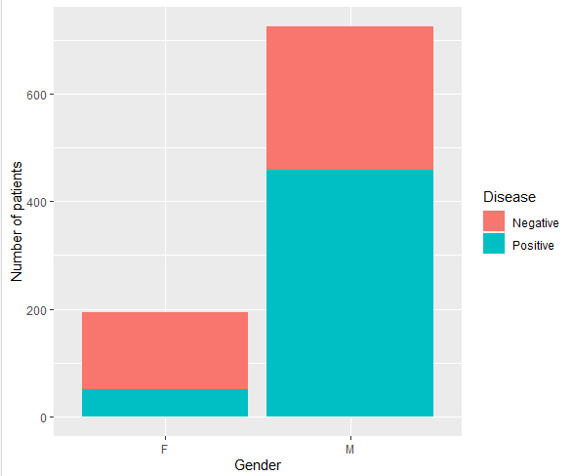
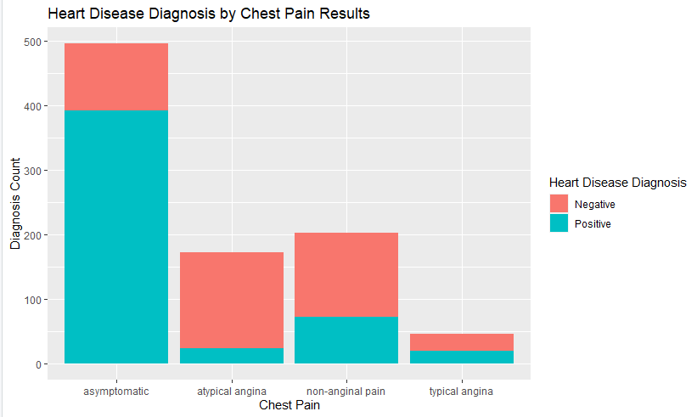
Data Visualization and Key findings
Out of 916 records, 193 records are of females, and 725 are of males.
Out of 725 male patients, 458 patients had heart disease that is 63% of total male patients.
Out of 193 female patients,50 patients had heart disease that is 26% of total female patients.
we can conclude from the above plotting that men are more likely to have heart diseases than women.
Most of the heart disease diagnosis by chest pain are asymptomatic. That is most heart disease have no symptom at all
Angina is when your heart muscle doesn't get enough blood. Angina can be identified: as typical, atypical, and non-anginal chest pain.
we can see from the plot that typical angina has the 2nd highest diagnosis count.

Slide 5
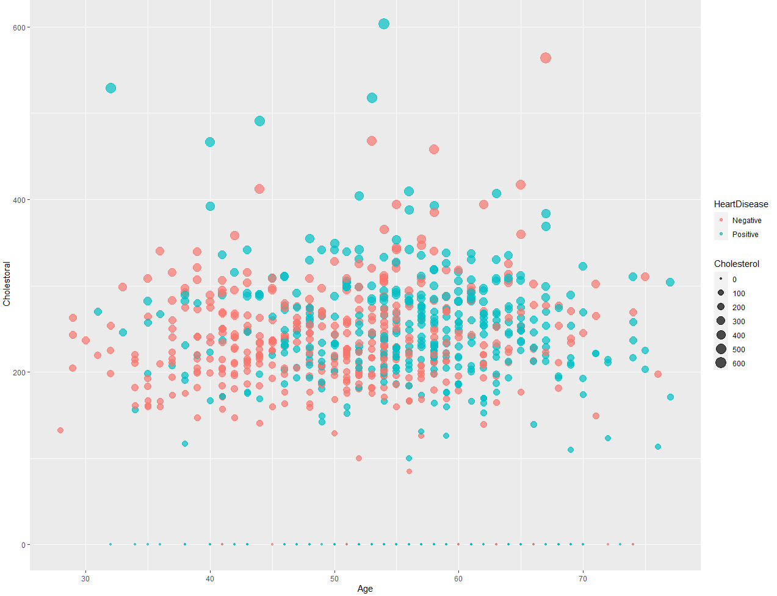
Data Visualization and Key findings
The scatter plot shows patients age, their cholesterol level and positive and negative patients are differentiated using different color.
The highest cholesterol level if 600+ of a patient who is suffering from heart disease where as the highest cholesterol level of patient who is not suffering from heart disease is the rage of 500-600.
From the scatter plot, we can say that people between 55-65 years old have high cholesterol rates, which explains why they were diagnosed with heart disease.
We can see that people with high cholesterol rates are at risk of having heart disease.

Slide 6
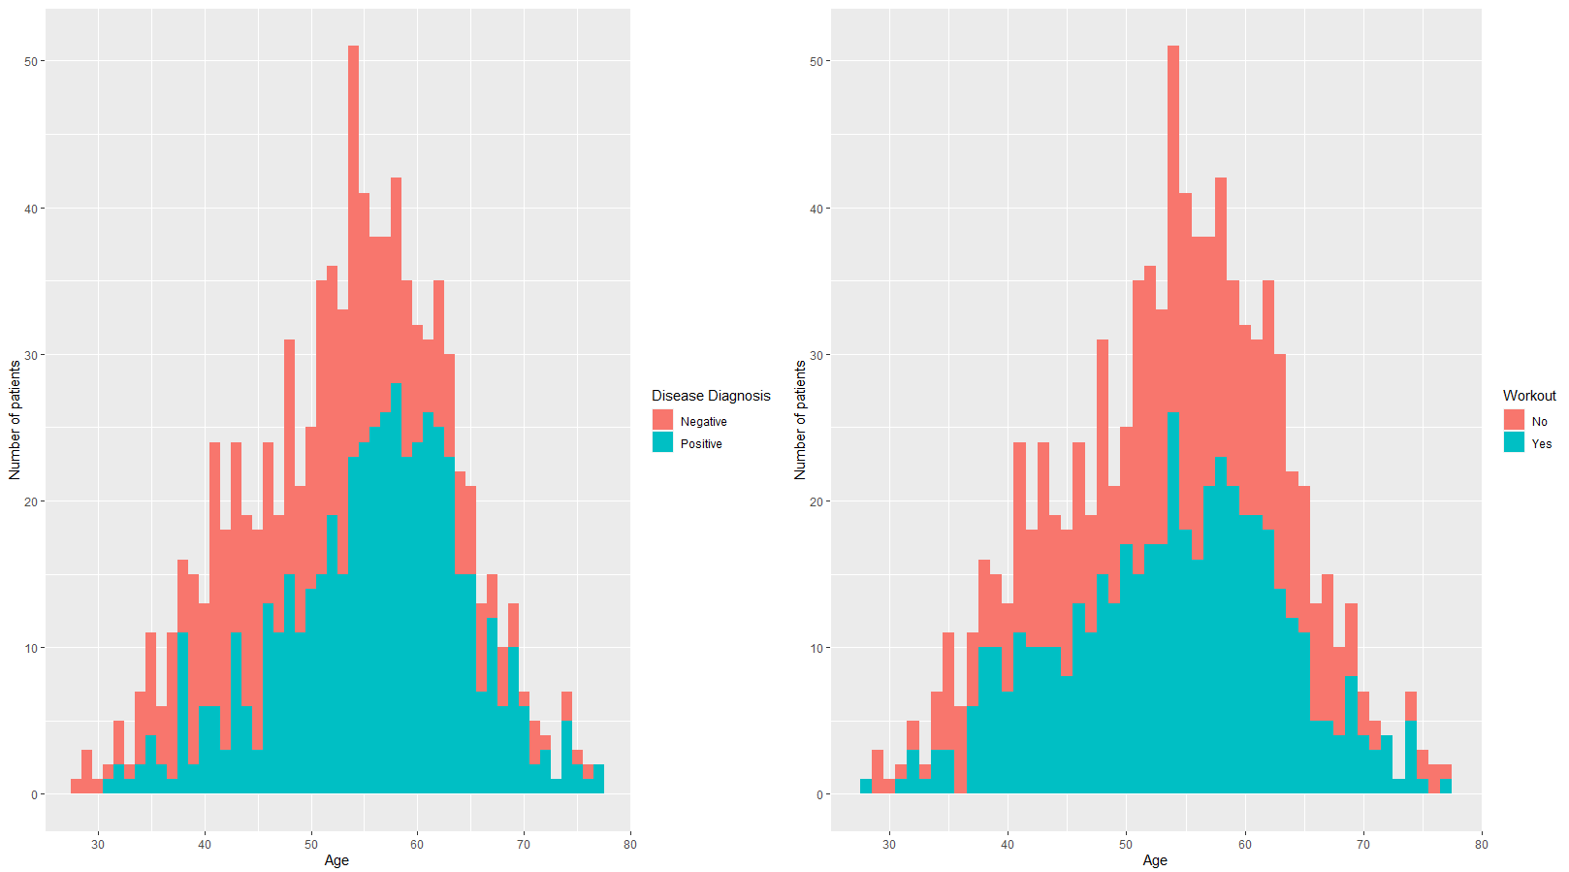
Computation and adding
of new column variable
Introduced new variable 'workout' with randomizing yes and no value.
From the hypothesis, we can say that the age group of 60-70 does not work out due to which their cholesterol are more which indirectly affects the heart and cause heart disease.
If the dataset had the variable 'workout', we could have understood if physical fitness helps the body avoid heart disease.

Slide 7
Conclusion
From the dataset, 63% of the male patients had positive heart disease.
In heart disease maximum patients did not had chest pains, Also patient with non anginal pain were the 2nd highest count in detecting the heart disease.
We can see that people with high cholesterol rates are at risk of having heart disease. The age group of 55-65 have high cholesterol level, which is why they were diagnosed with heart disease.
From our hypothesis we can say that workout helps in reducing cholesterol level which can help one to be fit and avoid heart disease.
There do not seem to be any significant linear relationships between the numerical variables.

Slide 8
REFERENCE
Fedesoriano. (2021, September 10). Heart failure prediction dataset. Kaggle. Retrieved October 29, 2021, from https://www.kaggle.com/fedesoriano/heart-failure-prediction/version/1.
Datanovia. (2018, October 19). Reorder Data Frame Rows in R. https://www.datanovia.com/en/lessons/reorder-data-frame-rows-in-r/
Fletcher, J. (2020, January 5). What should my cholesterol level be at my age? MEDICAL NEWS TODAY. https://www.medicalnewstoday.com/articles/315900#recommended-levels
Hebbali, A. (2021, June 5). Chapter 8 Bar Plots | Data Visualization with ggplot2. Rsquaredacademy.Com. https://viz-ggplot2.rsquaredacademy.com/ggplot2-bar-plot.html
Non-Cardiac Chest Pain. (2020, October 16). Cleveland Clinic. https://my.clevelandclinic.org/health/diseases/15851-gerd-non-cardiac-chest-pain
Factor variables | R Learning Modules. (2013, September 23). UCLA: Statistical Consulting Group. https://stats.idre.ucla.edu/r/modules/factor-variables/

Slide 9
THANKYOU

